Slide 1
Communication
Lecture 9
February 5, 2024

Slide 2
Communication Cost
Startup time (t_{s})
  Time required to handle a message at the sending and receiving nodes
Per-hop time (t_{h})
Per-word transfer time (t_{w}) / Bandwidth (B)
Transfer time of n words on l links = ?
Notes:
Startup time (ts): The startup time is the time required to handle a message at the
sending and receiving nodes. This includes the time to prepare the message (adding
header, trailer, and error correction information), the time to execute the routing
algorithm, and the time to establish an interface between the local node and the router.
This delay is incurred only once for a single message transfer.
1.
Per-hop time (th): After a message leaves a node, it takes a finite amount of time to
reach the next node in its path. The time taken by the header of a message to travel
between two directly-connected nodes in the network is called the per-hop time. It is also
known as node latency. The per-hop time is directly related to the latency within the
routing switch for determining which output buffer or channel the message should be
forwarded to.
2.
Per-word transfer time (tw): If the channel bandwidth is r words per second, then each
word takes time tw = 1/r to traverse the link. This time is called the per-word transfer
time. This time includes network as well as buffering overheads.

Slide 3
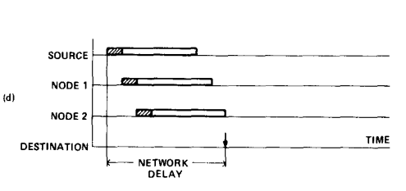
Routing
t_{s} + l(t_{h} + n/B)
t_{s} + l.t_{h} + n/B
Store-and-forward
Cut-through
Reference: Chapter 2 of “Introduction to Parallel Computing”, Ananth Grama et al.
Notes:
In store-and-forward routing, when a message is traversing a path with multiple links, each
intermediate node on the path forwards the message to the next node after it has received and
stored the entire message.
At each link, the message incurs a cost th for the header and twm for the rest
of the message to traverse the link. Since there are l such links, the total time is (th + twm)l.
Therefore, for store-and-forward routing, the total communication cost for a message of size
By forcing
all packets to take the same path, we can eliminate the overhead of transmitting routing
information with each packet. By forcing in-sequence delivery, sequencing information can be
eliminated.
original message is broken into two equal
sized parts before it is sent. In this case, an intermediate node waits for only half of the original
message to arrive before passing it on.
By forcing
all packets to take the same path, we can eliminate the overhead of transmitting routing
information with each packet. By forcing in-sequence delivery, sequencing information can be
eliminated. By associating error information at message level rather than packet level

Slide 4
Reference: “Parallel Computer Architecture”, Culler et al.

Slide 5
Effective Bandwidth
Barthels et al., SIGMOD’15

Slide 6


Latency and Bandwidth
SOURCE: ECESSA
SOURCE: DAILYNEWS

Slide 7
Hockney Model / Postal Model
Communication time = t_{s} + l.t_{h} + n/B
  Communicate in bulk
  Communicate over fewer hops
  Communicate less volume
Simplified model: T_{comm} = L + n/B
What are the factors that may reduce the effective bandwidth?

Slide 8

A Realistic Cost Model
Difficult to analyse
Effective communication time
L + n/B + contention
Reduce communication time by reducing
Overhead (per-hop time)
Contention
Simplified model (without congestion): T_{comm} = L + n/B
Simplified model (with congestion): T_{comm_congest} = L’ + n/B’
https://www.smartmotorist.com
Notes:
Pg 154

Slide 9
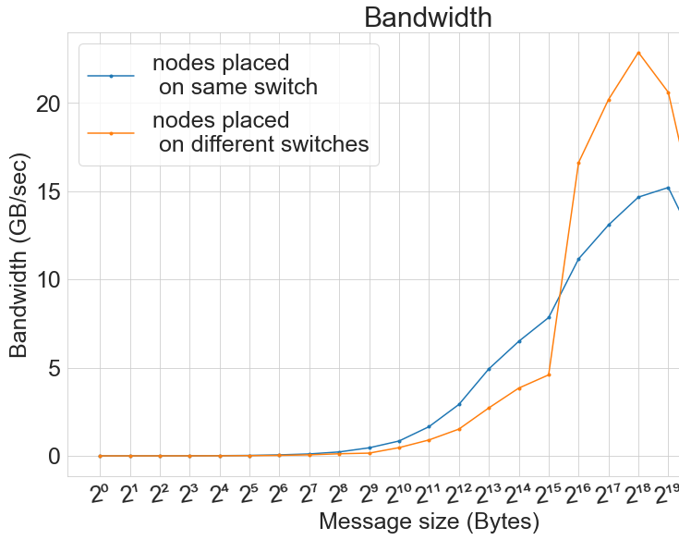
Latency and Bandwidth (PARAM Sanganak)
Image Credit: S. Aggarwal

Slide 10
Effect of Network Topology
0
1
0
1
2
3
3
2
Communication pattern: 0 -> 2, 1 -> 3 (N bytes)
Link bandwidth: b bytes/sec
Communication time?

Slide 11

Effect of Node Allocation
Source: A Pal et al.
https://www.hpc.iitk.ac.in

Slide 12
Communicator
Object containing a group of processes
Representative of communication domain
Predefined:
  MPI_COMM_WORLD
  MPI_COMM_SELF
Memory proportional to #processes in the group
Several communication contexts may co-exist within a single communicator
Notes:
Grouping logically related processes into communicators substantially reduces number of calling arguments
Distinct communicators in the same process have distinct contexts. A context is essentially a system-managed tag (or tags) needed to make a communicator safe for point-to-point and MPI-defined collective communication. Safety means that collective and point-to-point communication within one communicator do not interfere, and that communication over distinct communicators don’t interfere. (mpi31-report.pdF)
Contains a mapping from MPI process ranks to processor ids

Slide 13
Process Group
Ordered set of processes
Ranks are contiguous
Base group – associated with MPI_COMM_WORLD
  MPI_Comm_group (MPI_Comm comm, MPI_Group *group)
MPI_Group object
  MPI_Group_rank, MPI_Group_size
Unions and intersections of groups
Not used in communication context

Slide 14
MPI_COMM_WORLD

Slide 15
Intra-Communicators
- Logical subset
- Different contexts
Intra-communicator
Intra-communicator
Notes:
Time to complete collective op increases with #processes
Yields much better scaling behavior

Slide 16
Intra-Communicators
Group 1
Group 2
Intra-communicator
Intra-communicator
Notes:
Time to complete collective op increases with #processes
Yields much better scaling behavior

Slide 17
Inter-Communicators
Inter-communicator
between two groups

Slide 18
MPI_COMM_SPLIT
MPI_Comm_split (
MPI_Comm oldcomm, int color, int key,
MPI_Comm *newcomm
)
Collective call
Logically divides based on color
  Processes of same color form a group
Rank assignment based on key
Output: newcomm
Notes:
An MPI process may supply the color value MPI_UNDEFINED, in which case newcomm returns MPI_COMM_NULL (pg 371)

Slide 19
Logical Subsets
13
0 → 0
2 → 1
4 → 2
…
2
5
16
10
14
1
17
6
11
8
9
0
3
19
15
1 → 0
3 → 1
5 → 2
…
7
12
4
18
How do you assign one color to odd processes and another color to even processes ?
color = rank % 2

Slide 20
MPI_Comm_split Example Code
Output
for P=8
int newrank, newsize, color = myrank%2;
MPI_Comm newcomm;
MPI_Comm_split (MPI_COMM_WORLD, color, myrank, &newcomm);
MPI_Comm_rank (newcomm, &newrank);
MPI_Comm_size (newcomm, &newsize);
printf ("%d: %d of %d\n", myrank, newrank, newsize);
MPI_Comm_free (&newcomm);
0:
1:
2:
3:
4:
5:
6:
7:
0 of 4
0 of 4
1 of 4
1 of 4
2 of 4
2 of 4
3 of 4
3 of 4

Slide 21
MPI_Group
MPI_Group_incl (
MPI_Group g_group,
int N,
const int ranks[],
MPI_Group *new_group);
MPI_Comm_create_group (
MPI_Comm comm,
MPI_Group new_group,
int tag,
MPI_Comm *new_comm);
2
5
1
6
0
8
3
7
9
4
MPI_Group_incl
0
2
4
6
8
MPI_Group_excl
1
3
5
7
9
Notes:
MPI_COMM_CREATE_GROUP is similar to MPI_COMM_CREATE; however, MPI_COMM_CREATE must be called by all MPI processes in the group of comm, whereas MPI_COMM_CREATE_GROUP must be called by all MPI processes in group, which is a subgroup of the group of comm.

Slide 22
MPI_Group Example Code
int ranks[] = {0,2,4,6,8};
// Construct a group containing even ranks in g_group
MPI_Group new_group;
MPI_Group_incl (g_group, N, ranks, &new_group);
// Create a new communicator based on the group
MPI_Comm new_comm;
MPI_Comm_create_group (MPI_COMM_WORLD, new_group, &new_comm);

Slide 23
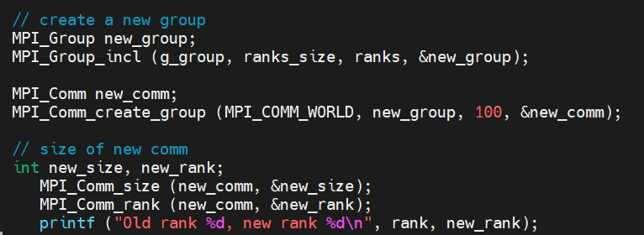
MPI_Group_incl code (group.c)

Slide 24
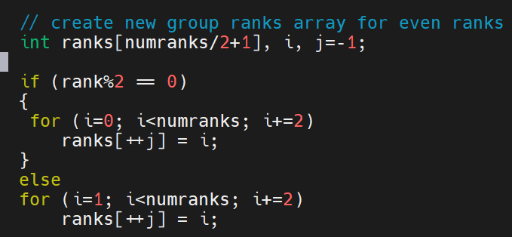
Code (group.c)

Slide 25
Example
Q: Group every third process and create a sub-communicator
  MPI_Comm_split
  MPI_Group_incl + MPI_Comm_create_group
// get number of processes
// get my rank
// get the world group
// create new group ranks array
// create a new group and communicator
// get size of new comm and new rank

Slide 26
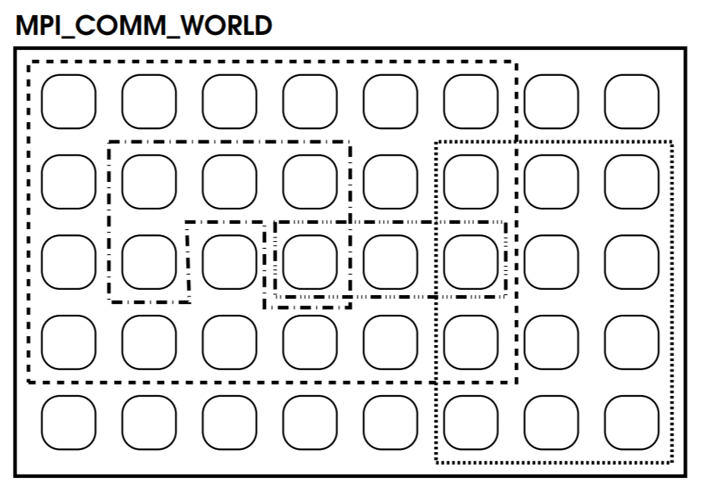
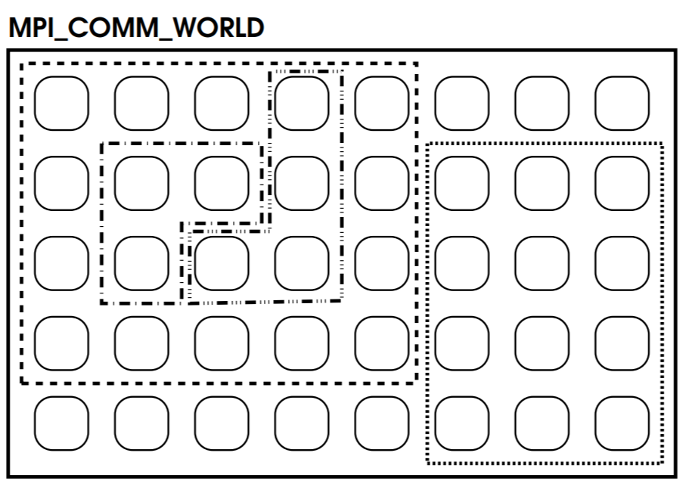
MPI Sub-communicators
Overlapping
Non-overlapping
Source: Maclaren slides

Slide 27
Usage of Sub-communicators
Producer processes
Consumer processes

Slide 28
Producer-Consumer Example

Slide 29
Sub-communicator Example
0 | 1 | 2 | 3 | 4 | 5 | 6 | 7
8 | 9 | 10 | 11 | 12 | 13 | 14 | 15
16 | 17 | 18 | 19 | 20 | 21 | 22 | 23
24 | 25 | 26 | 27 | 28 | 29 | 30 | 31
Question: Split row-wise
Input: 2D topology (rows, cols)
4 x 8 2D virtual process topology

Slide 30
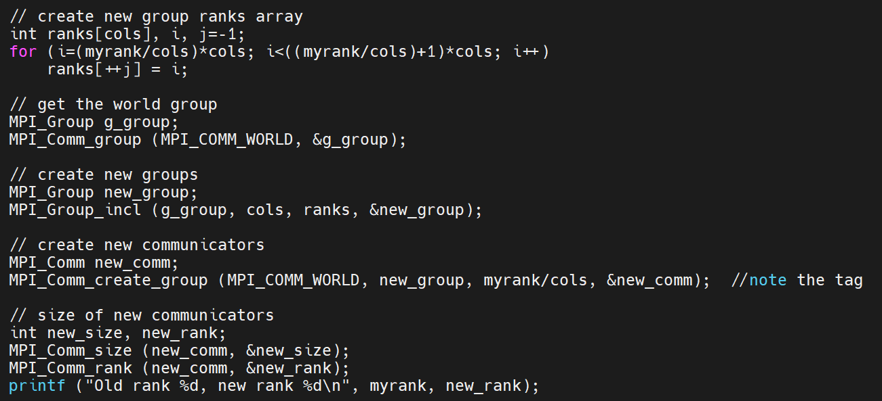

Slide 31
Sub-communicator Example
0 | 1 | 2 | 3 | 4 | 5 | 6 | 7
8 | 9 | 10 | 11 | 12 | 13 | 14 | 15
16 | 17 | 18 | 19 | 20 | 21 | 22 | 23
24 | 25 | 26 | 27 | 28 | 29 | 30 | 31
Question: Split column-wise
Input: 2D topology (rows, cols)
4 x 8 2D virtual process topology

Slide 32
Sub-communicator Example
0 | 1 | 2 | 3 | 4 | 5 | 6 | 7
8 | 9 | 10 | 11 | 12 | 13 | 14 | 15
16 | 17 | 18 | 19 | 20 | 21 | 22 | 23
24 | 25 | 26 | 27 | 28 | 29 | 30 | 31
Question: Every process computes local array statistics (sum/average).
Select 1 process per row to write to a file.
Input: 2D topology (rows, cols)
4 x 8 2D virtual process topology
Homework

Slide 33
Process Mapping
0
1
2
3
4
5
6
7
2 X 4 virtual topology
Physical topology

Slide 34
Collective Communication
int MPI_Gather (sendbuf, sendcount, sendtype, recvbuf, recvcount, recvtype, root, comm)
0 | 1 | 2 | 3 | 4 | 5 | 6 | 7
8 | 9 | 10 | 11 | 12 | 13 | 14 | 15
16 | 17 | 18 | 19 | 20 | 21 | 22 | 23
24 | 25 | 26 | 27 | 28 | 29 | 30 | 31
Every process in comm should invoke
Gathers values from all processes to a root process
Arguments recv* not relevant on non-root processes
recvcount → size of any (single) receive
Distinct values (may be same) received from non-root processes at the root process
4 x 8 2D virtual process topology

Slide 35
Duplicate Communicator
MPI_Comm_dup (comm, newcomm)

Slide 36
Assignment 1: Due on February 10
Write a C MPI program to measure the performance of blocking P2P between different pairs of nodes (1 rank/node) on CSEWS for varying data sizes (1 KB, 100 KB, 1 MB, 8 MB, 32 MB, 64 MB, 128 MB). For each configuration execute 10 runs, select 2-3 different pairs of nodes.
1. Plot a graph (lineplot with error bars to show the variation. x-axis: data sizes, y-axis: times (seconds)
2. Summarize your observations from the runs (250 words).
Total marks: 30+20

Slide 37
Send 2D Array

Slide 38
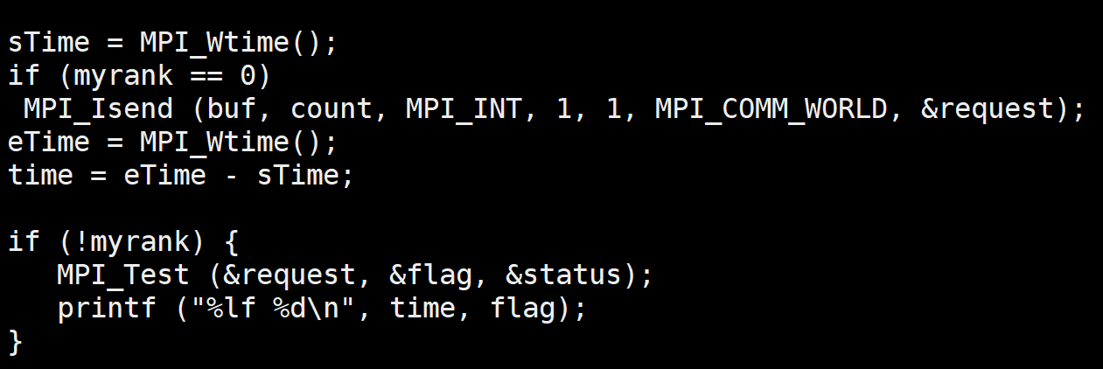
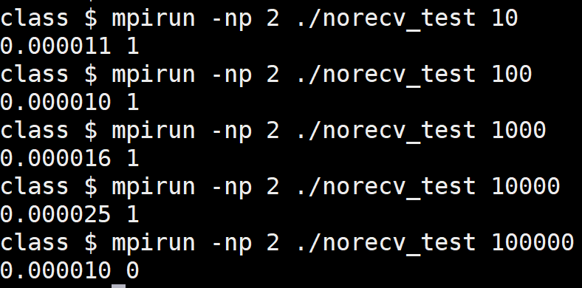
MPI_Test

Slide 39
Message Ordering
IF (rank.EQ.0) THEN
MPI_ISEND (buf1, count, MPI_INT, 1, 0, comm, req1)
MPI_ISEND (buf2, count, MPI_INT, 1, 0, comm, req2)
ELSE IF (rank.EQ.1) THEN
MPI_IRECV (buf1, count, MPI_INT, 0, MPI_ANY_TAG, comm, req1)
MPI_IRECV (buf2, count, MPI_INT, 0, 0, comm, req2)
END IF
MPI_WAIT (req1, status1)
MPI_WAIT (req2, status2)

Slide 40
MPI_Pack
int MPI_Pack (const void *inbuf, int incount, MPI_Datatype datatype, void *outbuf, int outsize, int *position, MPI_Comm comm)
MPI_Pack (&num1, 1, MPI_INT, buffer, 1000, &position, MPI_COMM_WORLD);
MPI_Pack (&num2, 1, MPI_INT, buffer, 1000, &position, MPI_COMM_WORLD);
MPI_Send (buffer, position, MPI_PACKED, dest, 0, MPI_COMM_WORLD);
MPI_Recv (recvbuf, 2, MPI_INT, source, 0, MPI_COMM_WORLD)

Slide 41
MPI_Unpack
int MPI_Unpack (const void *inbuf, int insize, int *position, void *outbuf, int outcount, MPI_Datatype datatype, MPI_Comm comm)
for (int r=0; r<6; r++)
MPI_Pack (&array[r][5], 1, MPI_INT, buffer, 1000, &position, MPI_COMM_WORLD);
MPI_Send (buffer, position, MPI_PACKED, dest, 0, MPI_COMM_WORLD);
MPI_Recv (recvBuf, count, MPI_PACKED, source, 0, MPI_COMM_WORLD, &status);
for (int r=0; r<6; r++)
MPI_Unpack (recvBuf, 1000, &position, &recvArr[r][0], 1, MPI_INT, MPI_COMM_WORLD);

Slide 42
MPI_PACK Example
source
dest
for (int r=0; r<6; r++)
MPI_Pack (&array[r][5], 1, MPI_INT, buffer, 1000, &position, MPI_COMM_WORLD);
MPI_Send (buffer, position, MPI_PACKED, dest, 0, MPI_COMM_WORLD);
MPI_Recv (recvColumn, count, MPI_INT, source, 0, MPI_COMM_WORLD, &status);

Slide 43
Communication Subsystem
Communication using sockets (one of the options)
MPI handles communications, progress etc.
Communication channels determine performance
Shared-memory queue for intranode messaging
  Per-process send/recv queue
Send queue
Recv queue
Reference: Design and Evaluation of Nemesis, a Scalable, Low-Latency, Message-Passing Communication Subsystem by Buntinas et al.

Slide 44
Communication Channels
Sockets for network I/O (wire protocol in PMI)
PMI is responsible for creating/initializing/cleanup
MPI handles communications, progress etc.
Reading (optional): Design and Evaluation of Nemesis, a Scalable, Low-Latency, Message-Passing Communication Subsystem
Notes:
The communication mechanisms in MPICH are called "devices". MPICH supports ch3 (default) and ch4 (experimental), as well as many third-party devices that are released and maintained by other institutes. ************************************* ch3 device ********** The ch3 device contains different internal communication options called "channels". We currently support nemesis (default) and sock channels. nemesis channel --------------- Nemesis provides communication using different networks (tcp, mx) as well as various shared-memory optimizations. To configure MPICH with nemesis, you can use the following configure option:
In the {\tt CH3\_TCP} device used on Linux clusters, TCP isused to support MPI communication. Connections between processes areestablished by the normal socket {\tt connect}/{\tt accept} mechanism.For this to work, before the first {\tt MPI\_SEND} from one process toanother, one process must have acquired a port from the operating systemand be listening on it with the normal {\tt socket}/{\tt bind}/{\tt listen}sequence. The other process, typically on a separate host, will executethe corresponding {\tt socket}/{\tt connect} sequence, at which time thefirst process will issue an {\tt accept}, establishing the TCPconnection.

